Slide 1
Leadership
Mollie Back
Morehead State University

Slide 2
Objectives
Analyze the importance of the leader’s role to the organization and the effectiveness of the individual in the role
Relate insights and knowledge gained through the Learning experience to course and address the following concepts:
(1) major role responsibilities
(2) personal leadership style of the chosen leader
(3) alignment of personal values with organizational mission
(4) trends in healthcare that will impact patient care delivery

Slide 3

What is a leader?
Everyone has a different definition and view of a leader.
Tomey (2009) defines leaders as people who “need to do the right things, are challenged by course, focus on purposes, and have a future time frame” (Tomey, 2009, pg. 180).
Characteristics that make a good leader: honesty, passion, focused, driven, confidence, supportive, appreciative, good communication, etc.

Slide 4
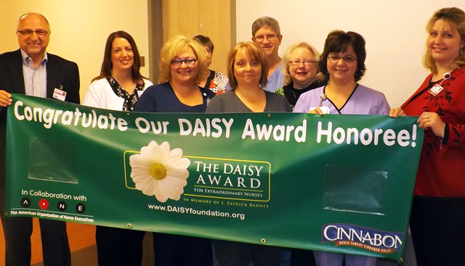
Interviewed leader
Roberta Butler, RN MSN was chosen to be the interviewed leader.
Roberta is the clinical manager of the Women’s Care Unit at St. Joseph Mt. Sterling Hospital
The clinical manager has several important duties and is a crucial member of our unit and the hospital.
Pictured here is Roberta, and other members of the Women’s Care Unit, as she receives a DAISY Award. Roberta is 4th from the left in front row (gray scrubs)

Slide 5
Clinical manager
The clinical manager of the Women’s Care unit is an important role at SJMS .
Roberta ensures that the unit runs smoothly.
Typical duties include: managing staff; scheduling, recruitment of new employees, development of, and appraisal of staff; overseeing day-to-day management; developing and implementing policies and directives; attending meetings; and handling communications.

Slide 6
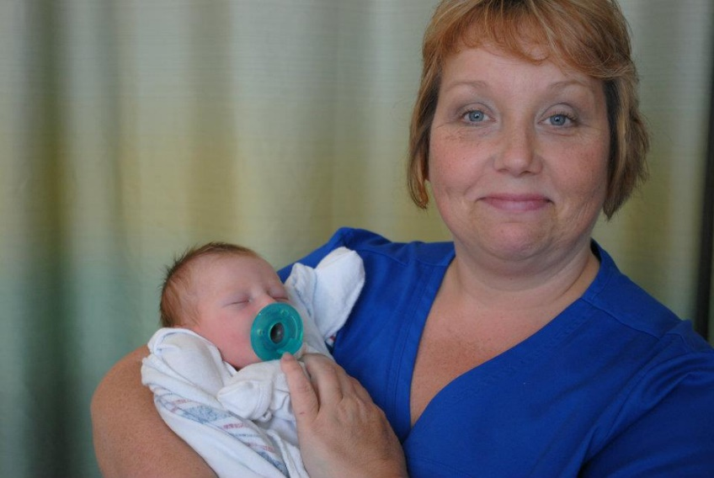
Importance of clinical manager
Roberta is important to our unit because she:
delivers a high quality of patient care
constantly strives to improve care.
works hard to ensure us a safe place to work
maintains continuous relationships across all team members
is knowledgeable of environmental resources
Berta delivering quality care to a precious newborn, always with a smile and kind heart.

Slide 7
Effectiveness
Roberta is extremely effective in her role as clinical manager.
She ensures all of her job duties (and more) are completed to the best of her ability.
She is resourceful in searching for answers or ways of best practice.
Staff nurses of the Women’s Care Unit hold Roberta in high regard.
Roberta is respected among nurses, physicians, housekeepers, other unit managers as well as other healthcare team members.
Inspire yourself
and others will be inspired.
Motivate yourself
and others will be motivated
Develop yourself
and others will start to develop themselves.
Be an example first
and then the world changes around you.
-Unknown
One of Roberta’s favorite quotes. She has this framed on her desk.

Slide 8

Major role responsibilities
responsible for own decisions and actions
carries out responsibilities within the professional boundaries
accountable for maintaining practice standards
responsible for continuous improvement of current practice
development of, and appraisal of staff
overseeing day-to-day management (scheduling, ordering unit supplies)
participates in developing and implementing policies and directives

Slide 9

Personal leadership style
Mixture of leadership styles:
  servant leader
  situational leader
  innovated leader

Slide 10
Personal leadership style
servant leader: committed to coworkers; makes decisions in regards to what is best for all involved; helps others to improve and achieve
situational leader: adjusts leadership skills to best fit the task at hand
innovated leader: bring new ideas to the unit; not a “glory seeker”; leads from the side and empowers staff

Slide 11
Personal values
Kentucky One Health Values: R.I.C.E.
Reverence. Integrity. Compassion. Excellence.
Roberta’s values are, for the most part, congruent to the institution’s values.
In Roberta’s words, “ I respect our patients and their families and those who serve them. I have integrity in that I strive to do things the right way and for the right reason. I have compassion and share others’ joys and sorrows, whether it is patients and their families or our staff. I portray excellence by living up to high standards. No, I am not perfect nor do I claim to be. Some days, yes, it is hard to be respectful, compassionate and do the right things because, let’s face it, we are human.”

Slide 12

Trends in healthcare that will impact patient care delivery
continued focus on patient safety and quality outcomes
new care models
the economy
employment
healthcare coverage
access to healthcare
healthcare costs
increased technology based care
focus on cost management
(O’Dell, 2014)

Slide 13
Reference
O’Dell, G. J. (2014). Take a look at how market forces will impact health care. Retrieved March 22, 2015, from http://www.hhnmag.com/display/HHN-news-article.dhtml?dcrPath=/templatedata/HF_Common/NewsArticle/data/HHN/Magazine/2014/Sep/gate-aha-environment-scan-2015
Tomey, A. M. (2009). Guide to nursing management and leadership (8th ed.). St. Louis, Missouri: Elsevier.

